Slide 1
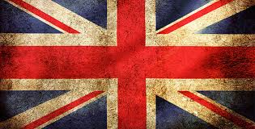
British Rule in Detroit 1760-1787
http://listverse.com/2012/07/10/top-10-british-inventions-that-changed-the-world/

Slide 2
Detroit under British rule 1760-1787
Detroit and Michilimackinac were the only British forts. Detroit has 2,000 residents and 300 buildings.
French were allowed to remain in Detroit area. Abraham Chapman from Montreal is believed to be first Jewish settler in Detroit in 1762.
In Michilimackinac, Major Robert Rogers ignored British orders to trade near the fort, and used liquor in fur trade, and traded on his own account.
British dug a single mine in 1772, but failed to obtain enough copper, so gave up
After American Revolution, British stayed in Detroit until 1796, in violation of the Treaty of Paris in 1783.

Slide 3
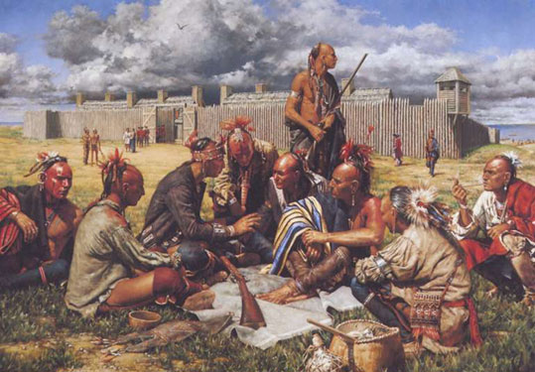
Pontiac’s Rebellion (Conspiracy) - 1763
Indians were angered by Amherst’s lack of generosity
Pontiac and 60 warriors try to take Fort Detroit (120 men) on May 7, 1763 by concealing weapons under blankets and pretending to want a meeting with Major Henry Gladwin. Gladwin found out plan, and prevented it.
Indians start killing British outside of fort, but fail to take Fort Detroit, which was reinforced by British ships.
May 25, 1763 – Potawatomis capture Fort St. Joseph in Niles, MI and killed 15 British soldiers
Indians and French captured 9 of 12 British forts, including Michilimackinac, but failed to capture Fort Detroit.
http://www.michilimackinac.com/

Slide 4
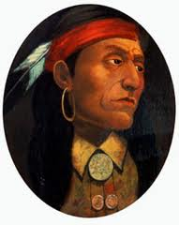
Chief Pontiac, 1763
“My children, you have forgotten the customs and traditions of your forefathers….You have bought guns, knives, kettles, and blankets from the white man until you can no longer do without them; and what is worse, you have drunk the poison firewater, which turns you into fools. Fling all these things away; live as your wise forefathers did before you.”
http://en.wikipedia.org/wiki/Pontiac_(person)

Slide 5
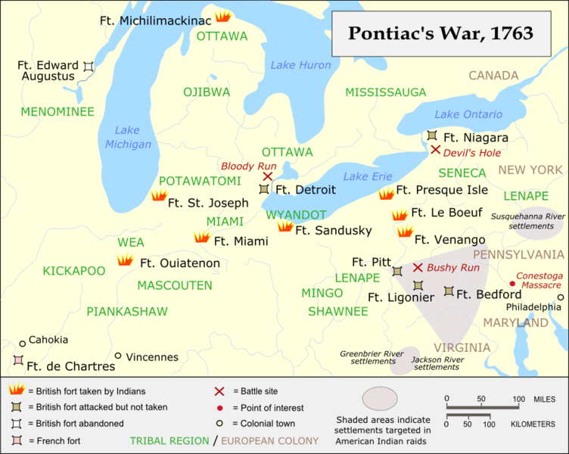
http://en.wikipedia.org/wiki/Pontiac's_War

Slide 6
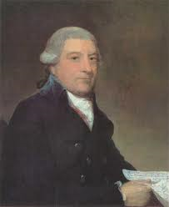
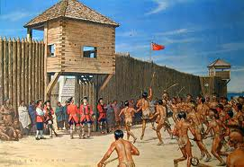
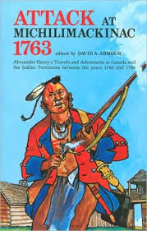
Lacrosse at Fort Michilimackinac – June 2, 1763
Chippewa chief Minavavana fools Captain George Etherington with a game of lacrosse outside the gates of Fort Michilimackinac. British trader Alexander Henry was one of a handful of survivors of the attack that killed about 27 Englishmen.
http://en.wikipedia.org/wiki/Alexander_Henry_the_elder
http://www.galafilm.com/chiefs/htmlen/ottawa/ev_fortvictories.html
“I saw a crowd of Indians within the fort furiously cutting down and scalping every Englishman they found… The dead were scalped and mangled; the dying were writhing and shrieking under the unsatiated knife and tomahawk; and from the bodies of some, ripped open, their butchers were drinking the blood, scooped up in the hollow of joined hands and quaffed amid shouts of rage and victory.”
Book cover: http://www.barnesandnoble.com/w/attack-at-michilimackinac-1763-david-a-armour/1112988872?ean=9780911872378

Slide 7
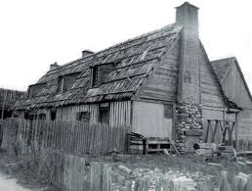
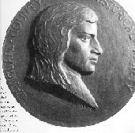
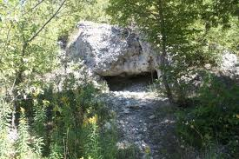
Alexander Henry HIDES
http://www.timothyjkent.com/rendezvouspics.htm
Langlade, the “Father of Wisconsin,” established a trading post in Green Bay in 1746. No portrait of him exists.
Skull Cave
http://www.examiner.com/article/hidden-mackinac-skull-cave
http://www.rootsweb.ancestry.com/~wilchs/lchistory.htm
Henry hid in the house of Charles Langlade, a French-Canadian fur trader and the son of the sister of an Ottawa war chief. Langlade intervened to save the life of Captain Etherington and another officer by cutting the ropes that bound them: “'If you are not content with what I have done, I am ready to meet you.”
“When daylight visited my chamber, I discovered with feelings of horror that I was lying on nothing less than a heap of human bones and skulls which covered all the floor.”
Alexander Henry lived until 1824, 61 years after the attack on Ft. Michilimackinac. He introduced John Jacob Astor to the fur trading business, and he made Montreal the commercial center of Canada.
http://en.wikipedia.org/wiki/Alexander_Henry_the_elder

Slide 8
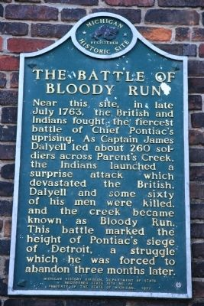
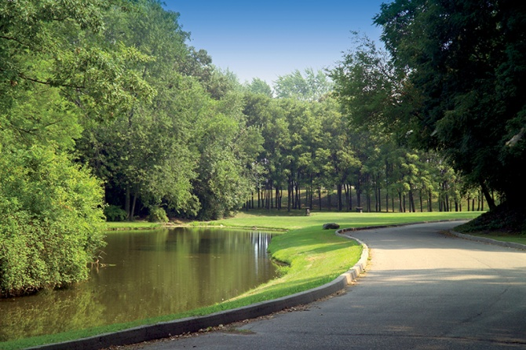
Battle of Bloody Run – July 31, 1763
Pontiac and 400 Indians ambush 260 British soldiers two miles from Fort Detroit near Parent’s Creek that used to run through today’s Elmwood Cemetery. The creek turned red with the blood of sixty men who died.
British ships continued to supply Detroit, so Indians could not take fort.
Oct. 31 – Pontiac surrenders as Indian allies leave for the winter
July 1766 – Peace treaty signed, and Pontiac pledges to never again fight the British. Killed by anti-British Indians in 1769.
http://detroit1701.org/Bloody%20Run%20Marker.html
This is what remains of Parent’s Creek in Elmwood Cemetery
http://www.elmwoodhistoriccemetery.org/breaking-news/battle-of-bloody-run-celebrates-its-250th-anniversary/

Slide 9
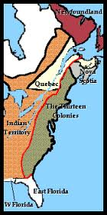
Proclamation of 1763
“Indian Territory” created west of Appalachians, No settlement of land west of Appalachians, and no purchases except by imperial agents.
Intended by King George III to be temporary until land could be bought from Indians. Feared Indian revolt.
Land was under military rule.
Prevention of westward expansion angered colonists.
Quebec Act of 1774 ended military rule, and made Michigan part of the province of Quebec.
http://www.ushistory.org/declaration/related/proc63.htm

Slide 10
Detroit loses population in 1764
Indian uprising in 1763 encourages many Detroiters to move to St. Louis, in violation of the Proclamation of 1763.
From 1760 to 1773, Detroit population falls from 2,000 to 1,400, but Detroit is still the center of fur trade in the region.
In 1764, the British build the Citadel, or barracks for 200-300 troops. The Citadel is later used to hold American prisoners during the Revolutionary War.

Slide 11
Hog Island (aka Belle Isle)
British Lieutenant George McDougall buys Hog Island (Iles Aux Cochons) in 1769 from Chippewas for 8 barrels of rum, 3 rolls of tobacco, 6 pounds of vermilion paint, and a wampum belt.
McDougall sold island to William Macomb in 1794, who then sold it to Barnabas Campau in 1817 for $5,000. His son, Alexander, built a summer home there, which is now used as the park offices.
1845 – Name changed to Belle Isle to honor Lewis Cass’s daughter
1879 – Campau family sells island to Detroit for $200,000

Slide 12
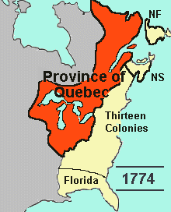
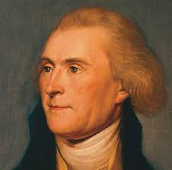
Quebec Act of 1774
MICHIGAN BECOMES PART OF CANADA, with Henry Hamilton in charge in Detroit
Governor of Quebec appointed a legislative council for Detroit. French civil law prevailed, except for British criminal law.
French Roman Catholics had religious freedom
French habitants remained loyal to British during Revolutionary War, fearing the Protestant Puritans
Quebec Act was only “intolerable act” mentioned in Declaration of Independence, because did not allow for elected assembly
http://www.slmc.uottawa.ca/?q=treaty_versailles
http://theworldbyroad.com/2012/06/traveling-makes-you-unhappy/

Slide 13
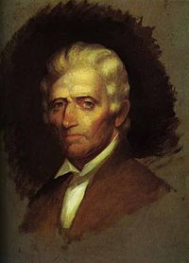
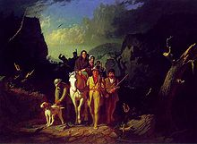
Daniel Boone and the Start of the War
Daniel Boone explored in future state of Kentucky in 1767, angering Indians.
Led to brief Dunmore’s War in 1774 between Virginians and Shawnee Indians for control of Kentucky and West Virginia.
1775 – Boone crossed the Cumberland Gap, and founded Boonesborough, KY
http://en.wikipedia.org/wiki/Daniel_Boone
http://en.wikipedia.org/wiki/Daniel_Boone

Slide 14
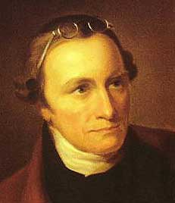
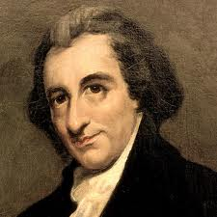
Causes of the American Revolution
https://www.thefederalistpapers.org/category/founders/patrick-henry
http://www.history.org/foundation/journal/spring09/deism.cfm
Patrick Henry
Thomas Paine
British imposed taxes (on tea, sugar, etc.) on New Englanders to pay for defense and administration of Western forts in Michigan and Ohio Valley to protect the fur trade that benefited London merchants
Virginians could not settle on Western lands. Only licensed British fur traders could.
Virginians united with New Englanders in war.
No major battles fought in Michigan, but the state was the center of British power in the West. Only the 13 original colonies demanded independence.

Slide 15
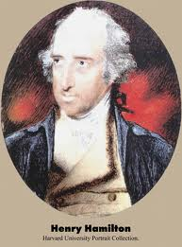
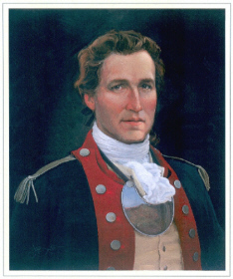
Hamilton vs. Clark
http://franceshunter.wordpress.com/2010/02/02/george-rogers-clark-and-the-taking-of-vincennes-part-i/
http://www.grccsar.org/grc/
Henry Hamilton (“the hair buyer”), the lieutenant- governor of Detroit, paid Indians for the scalps of Kentuckians, and provided them with weapons
Fort Detroit held 500 American prisoners in 1780, including Daniel Boone in 1778.
Kentuckian George Rogers Clark led Americans in attack of British forts in Ohio Valley
Hamilton captured Fort Vincennes in Indiana, but Clark attacked with 172 men in February 1779 when Hamilton had only 79 men. TURNING POINT IN REV. WAR
Hamilton was captured, and spent a few months in jail in Williamsburg, VA, was released, and then made Governor of Bermuda
Clark was older brother of William Clark, the famous explorer with Meriwether Lewis.

Slide 16
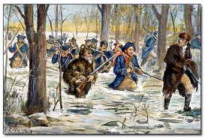
http://usrevolutionbrp.blogspot.com/2011/04/battle-of-vincennes.html
The Battle of Vincennes was a turning point in the American
Revolution, as Clark marched 180 miles through wet, icy terrain.
Half of Clark’s troops were French. As a result, the Indians
switched allegiance from British to Americans. In June 1779,
The Three Fires declared their neutrality.

Slide 17
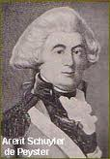
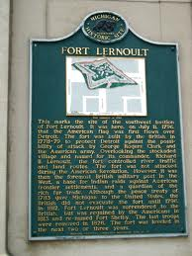
Fort Lernoult, 1778-1779
http://historydetroit.com/places/fort_british.php
British Captain Richard Lernoult builds new fort on higher ground behind old Fort Detroit
Detroit served as base for supplying Indians going on raids against the Americans in KY, PA, and NY.
http://detroit1701.org/Fort%20Lernoult%20Marker.html

Slide 18
Forts in Detroit
Fort Pontchartrain 1701-1760
RENAMED when British took over from French
Fort Detroit 1760-1805 (destroyed in 1805 fire)
Fort Lernoult (new) 1779-1796
RENAMED when Americans took over from British
Fort Detroit 1796-1813 (survived 1805 fire)
RENAMED during the War of 1812
Fort Shelby 1813 – 1827 (dismantled)
Fort Wayne 1851 – present

Slide 19
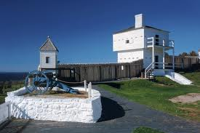
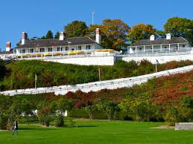
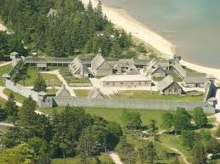
Fort Mackinac, 1779-1781
British move to Mackinac Island to build a new fort, Fort Mackinac, to replace older Fort Michilimackinac built in 1715
American George Rogers Clark was never able to assemble forces to attack the new Fort Lernoult or Fort Mackinac.
http://www.triptutor.com/travel_guides/north_america/usa/michigan/mackinac_island/attractions/fort_mackinac.html
http://paintyourlandscape.com/tag/mackinac-island-state-park/
http://mightymac.org/genealogy/
Fort Michilimackinac was disassembled and destroyed to build Fort Mackinac

Slide 20
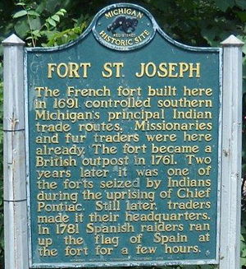
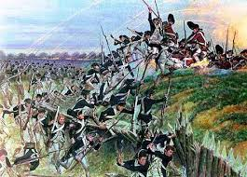
Michigan in the Revolutionary War
Trader Charles Langlade led 700 Indians armed at Fort Michilimackinac against the Americans, but failed to capture two American posts in Cahokia and St. Louis in 1780
Fort St. Joseph in Niles was briefly (24 hours) captured after a Spanish raid, so was the only Michigan city under four flags.
Fighting in the West continued for almost two years after the Battle of Yorktown in 1781. British stayed in control of Great Lakes area for several years more.
http://en.wikipedia.org/wiki/Fort_St._Joseph_(Niles,_Michigan)
In the Battle of Yorktown, George Washington and French officers Rochambeau and Marquis de Lafayette defeated Lord Charles Cornwallis by storming several British redoubts (defensive earthworks)
http://www.britishbattles.com/battle-yorktown.htm

Slide 21
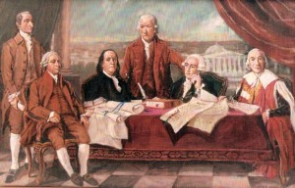
Treaty of Paris ends the war
13 Colonies granted independence, and British surrendered “Indian territory” between the Appalachians and Mississippi River.
Michigan becomes part of the new United States, but British refuse to surrender both forts in Detroit (Lernoult and Detroit), and in Mackinac.
Continuing British presence led to War of 1812, the “Second War of Independence.”
The Treaty of Paris was signed by Americans John Adams, Benjamin Franklin, and John Jay. They promised that no Loyalists would be punished.
http://galacticconnection.com/treaty-paris-1783/

Slide 22
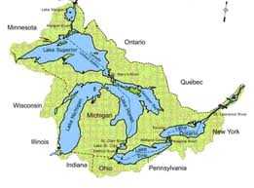
The Canadian Border
After the war, Americans gave the British the choice of making U.S.-Canada border along 45th parallel from the St. Lawrence River to the Mississippi River or the middle of the lakes: Superior, Huron, Erie, and Ontario.
Not surveyed for another 40 years, so border disputes remained. The western border between the U.S. and Canada (Oregon Territory) wasn’t resolved until 1846.
http://www.webanswers.com/science/geography/which-four-lakes-border-canada-d33952

Slide 23
The British remain in Michigan
British troops defied the 1783 Treaty of Paris ending the war by keeping troops in Detroit and Mackinac.
British loyalists moved to southern Ontario.
Michigan again administered by British law as a province of Quebec under the Quebec Act. Introduced trial by jury, a system of courts and English civil law replaced French law.
In 1791, divided into Upper Canada (Michigan) and Lower Canada (St. Lawrence area)
Life continued as before in Detroit but fur trade was declining, but not in Mackinac area

Slide 24
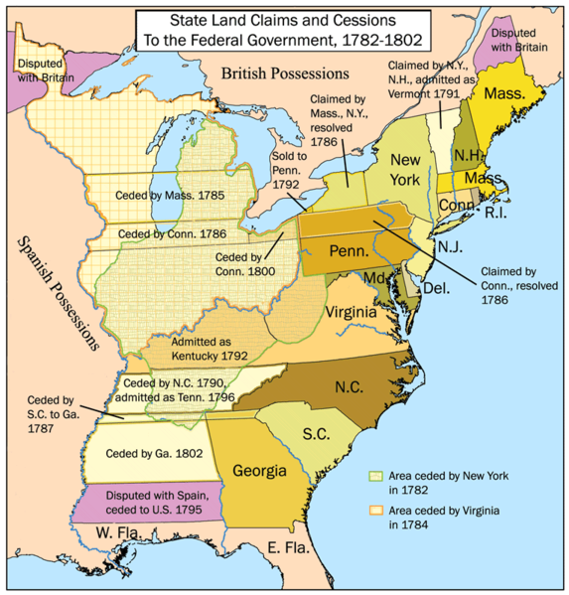
The Articles of Confederation, 1777
Try to create a federation of states
All lands in west, including Michigan, would be ceded to the federal government, and become part of the federal union
By 1784, all western states had ceded their land
http://users.humboldt.edu/ogayle/hist110/unit2/constitution.html

Slide 25
Land Ordinance of 1785
Survey land, and divide into townships of six square miles with 36 sections in each township (section = one square mile = 640 acres)
Base line = east-west line where survey starts (Eight Mile Road is also called Base Line Road)
Min. buy was 640 acres @ $1 per acre (sq. mi. cost $15,000 in today’s dollars)
Section 16 reserved for schools, and land sold would be used to build and maintain public schools. Michigan was first state to put proceeds into a state fund.
Price changed to $1.25/acre in 1820 ($24.50/acre today), so most Michigan settlers paid this amount to the Government
Squatters hoped to buy land when it went on the market
Stayed in effect until 1862 Homestead Act

Slide 26
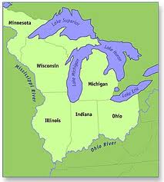
Land Ordinance of 1787 (aKA the Northwest Ordinance of 1787)
- Created the “Northwest Territory” from the Old Northwest (created boundaries for states).
Established stages that territories must go through to become states
Statement of rights for settlers
Congress bans slavery in NW Territory, a precedent used by abolitionists who urged Congress, not states to outlaw slavery prior to the Civil War.
http://www.ohiohistorycentral.org/w/Northwest_Territory?rec=772
Thomas Jefferson, Minister to France, wanted 10 new states, and he suggested names including Chersonesus, Sylvania, Assenisipia, Metropotamia, Polypotamia, Pelisipia, Saratoga, Washington, Michigania and Illinoia.
http://theworldbyroad.com/2012/06/traveling-makes-you-unhappy/

Slide 27
Northwest ordinance of 1787
Northwest Territory had a governor (served also as commander in chief of the militia) appointed by Congress, and each “state” had a territorial official.
Northwest Territory needed 5,000 “free male inhabitants of full age” to get limited self-government.
Voters (with >50 acres) elected a house of representatives, and governed along with a legislative council (5 men selected by Congress)
Need 60,000 free adults in NW Territory to form a government and create a constitution
Slavery was prohibited, but not greatly enforced. Some slaves in Michigan as late as 1830. Michigan, like the other states, had the right to legalize slavery, but did not.
Ordinance of 1787 established precedent that Congress could legislate on issue of slavery

Slide 28
Northwest ordinance promises;
“Religion, morality, and knowledge being necessary to good government and the happiness of mankind, schools and the means of education shall forever be encouraged.” Some opposed this language due to separation of church and state.
“The utmost good faith shall always be observed towards the Indians; their lands and their property shall never be taken from them without their consent; and in their property, rights and liberty, they shall never be invaded or disturbed, unless in just and lawful wars authorized by Congress.”

