Slide 1
POSTWAR DETROIT 1945-1974

Slide 2
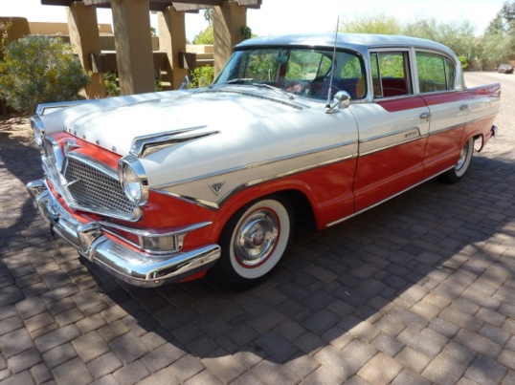
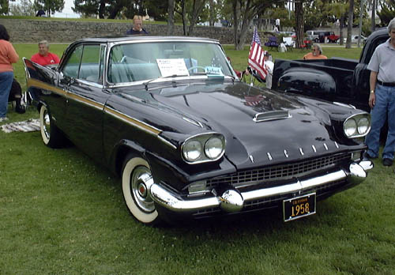
The Fall of Automotive Icons
1957 Hudson Hornet
Auto production reached 1929 peak in 1949.
Hudson automobiles merged with Nash in 1954, but ended production in 1957
Packard merged with Studebaker in 1954, but ended production in 1958.
Big Three had better factories and more dealerships
1950 – Ford surpasses Chrysler as #2 auto maker
http://blog.hemmings.com/index.php/2011/03/29/hemmings-find-of-the-day-1957-hudson-hornet-custom/
1958 Packard
http://en.wikipedia.org/wiki/1957_and_1958_Packards

Slide 3
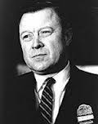
Walter Reuther
http://www.born-today.com/Today/09-01.htm
"There is no greater calling than to serve your fellow men. There is no greater contribution than to help the weak. There is no greater satisfaction than to have done it well."
1945 – GM strike – 113 days – Walter Reuther asked for 30% pay increase, but gets 15%
1946 - Elected president of the UAW, and purged union of communists
Wounded in arm in assassination attempt in 1948
Led the UAW (and CIO in 1952) until 1970. In the 1940s, UAW started siding with New Deal Democrats wanting reforms.
1955 – AFL merges with CIO.
1970 – Died in plane crash in Pellston, MI when his plane was likely sabotaged.

Slide 4
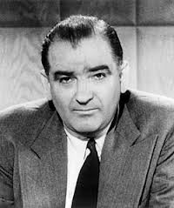
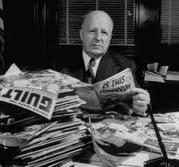
Another Red Scare
1948 - House Un-American Activities Committee (HUAC) formed headed by Richard Nixon. HUAC considered Detroit with all its foreigners as a prime target.
Sen. Joseph McCarthy (R-WI) started accusing state department officials and others of being communist in Feb. 1950 (eventually disgraced in 1954 Army-McCarthy hearings)
1950 – McCarran Act – all Communists must register with the Attorney General. Detroit voted to allow investigations into private lives of city employees, and created a Loyalty Commission.
1952 – Michigan passes the Communist Control Act created the state police “Red Squad.” Ended in 1977, it investigated thousands of Socialists, civil rights activists, antiwar demonstrators, and liberal politicians.
Detroit created its own squad. Police Commissioner Harry Toy: “un-American citizens ought either to be shot, thrown out of the country, or put in jail.” Labor leaders like Walter Reuther were investigated as well.
http://en.wikipedia.org/wiki/McCarthyism
McCarthy
Harry Toy served as a Michigan Supreme Court
Justice before coming police commissioner.
http://boards.collectorssociety.com/ubbthreads.php?ubb=showflat&Number=4092080&fpart=3

Slide 5
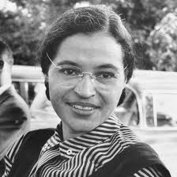
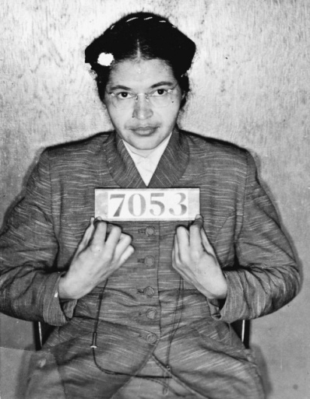
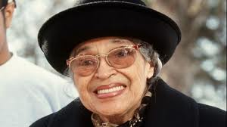
Rosa Parks
http://www.biography.com/people/rosa-parks-9433715
http://all-that-is-interesting.com/rosa-parks-mug-shot
Refused to move from her seat on a Montgomery, AL bus, starting the Montgomery Bus Boycott in 1955-56, led by Martin L. King (Start of Civil Rights Era)
Moved to Detroit in 1957 where her brother and sister-in-law lived after losing her department store job in Montgomery.
Disagreed with MLK, who believed in human rights for all races. MLK was too political, opposed the Vietnam War.
1965-1988 – worked as secretary and receptionist for Rep. John Conyers (D-MI)
Husband died of throat cancer in 1977
Attacked in her home in 1994, and moved to the Riverfront Towers, who tried to evict her in 2004
Died in 2005 at age 92
Parks is called the “Mother of the Civil Rights movement”
http://www.bet.com/news/national/2013/01/22/rosa-parks-statue-to-go-up-on-capitol-hill.html

Slide 6
Michigan in the 1950s
Prosperous time in which population grew 23% (7th largest state), but UP and northern Michigan lost residents
“Soapy” Williams was governor
1956 – Interstate Highway Act paid for 90% of 41,000 new highways across the U.S. (Mackinac Bridge completed in 1957 after 3 years and $100 million in bonds)
1959 – St. Lawrence Seaway opens, so freighters can travel from Michigan to Europe

Slide 7
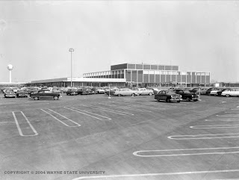
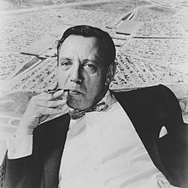
Northland Center
Opened in 1954 as nation’s modern shopping center built by Hudson’s (world’s second largest department store chain at one time)
Built for $20 million with 70 stores and anchored by Hudson’s with hotel, restaurant, and office complex. Land in suburbs (farmland) was cheaper than in central cities
Designed by Victor Gruen. Two years later, Gruen designed the first enclosed shopping mall in Minnesota. In 1959, he also designed the Kalamazoo Mall in 1959, the first outdoor pedestrian mall.
Enclosed in the 1970s
Hudson’s later built Eastland Mall (1957), Westland Mall (1965),
http://mallsofamerica.blogspot.com/2006/11/northland-center-mall.html
http://en.wikipedia.org/wiki/Victor_Gruen

Slide 8
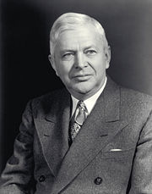
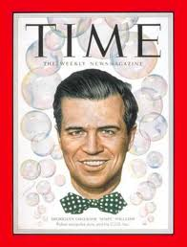
Gerhard Mennen (“Soapy”) Williams (D)
2nd longest-serving governor in state history (1948-1960)
Legislature remained Republican, and were more powerful nationally thanks to Eisenhower. Charles E. Wilson (“Engine Charlie”) president of GM, served as Eisenhower’s Sec. of Defense.
Education was chief priority. Reduced school districts from 5,200 to 2,100, built 30,000 classrooms, and hired 20,000 teachers. Built 7 new community colleges.
Prison reform – Model Corrections Act put administration under a state director and a five-man commission to improve efficiency and treatment
Civil Rights – Fair Employment Act of 1955 established commission to hear complaints of job discrimination
Increased Tourism – Advertised “water wonderland” and built Mackinac Bridge in 1957.
Succeeded by John Swainson in 1960 (Williams’ lieutenant governor)
Wilson
http://history.gmheritagecenter.com/wiki/index.php/Wilson,_Charles_E.
http://www.mybaycity.com/scripts/p3_v2/P3V3-0200.cfm?P3_newspaperID=NewspaperID&P3_ArticleID=1246

Slide 9
1959 Fiscal Crisis in “one industry state”
1946 – Voters agree that 77% of revenue from the sales tax should go to local schools and local governments causing years of financial trouble for the state
Created new taxes over next several years on cigarettes, diesel fuel, watercraft, liquor, and business activities
Recession of 1958 - Deficit was $21 million in 1958, and grew to $95 million in 1959. Relied on prosperity of auto industry, and defense contracts went to other states as did auto plants (employment in MI plants dropped to 293,000 in 1958 vs. 503,000 in 1953). Sales tax revenue declined significantly. “Payless payday” on May 5, 1959 was bad publicity. Automation claimed 100,000 auto jobs from 1958-62.
In 1959, MI creates a 1% “use tax” but state supreme court strikes down, so enacts “nuisance taxes” on beer, telephone bills, cigarettes, liquor, and the corporation franchise tax. Fiscal crisis hurt Gov. Williams and the Democrats
In 1961, state constitution was amended to allow a 4% sales tax, but deficit remained

Slide 10
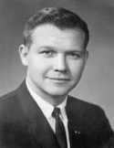
Election of 1960
Democrat Lieutenant Gov. John Swainson, 35, elected governor despite fiscal crisis
Swainson only lasted one term until defeated in 1962 by Republican George Romney
http://www.nndb.com/people/839/000122473/

Slide 11
Michigan in the 1960s
Detroit lost 159,000 residents (10%), and most central cities (except Ann Arbor and East Lansing) lost population. White population in central cities fell 17%, while nonwhite population went up 41% (20% unemployed in Detroit)
Recession of 1958 ended in 1962, and prosperity continued until 1973
Agriculture did well (19th in nation in 1967)
Attendance at 28 community colleges boomed, and MI ranked third in conferring master’s degrees

Slide 12
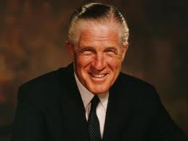
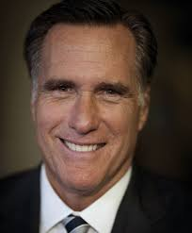
Gov. George W. Romney (1962-1969)
Born in 1907 in Mexico in a Mormon settlement, and moved to Utah at age 5
1940 – moved to Detroit to head the new office of the Automobile Manufacturers Association
1954 – helped Nash merge with Hudson Autos creating the new American Motors Corporation (AMC)
Credited with coining the term “compact” and sold many small Nash Ramblers by criticizing “gasguzzling dinosaurs” Won respect for the smallest auto maker
1959 – Founded Citizens for Michigan, a nonpartisan group trying to wrest control from special interest groups. CFM was key civic group involved in Constitution of 1963, but Romney had to declare himself a Republican to be elected to convention
1962 – Defeated incumbent Swainson for governor on campaign of “Let’s Get Michigan on the Move.” Won election, but most other Republicans lost.
http://abcnews.go.com/blogs/politics/2012/01/how-mitt-romneys-mexican-born-father-was-eligible-to-be-president/
http://www.alan.com/2012/10/15/ronald-reagans-budget-directors-takedown-of-mitt-romney/
Romney’s son, Mitt, ran for president in 2012

Slide 13
Gov. George W. Romney (1962-1969)
1968 – Ran for President of the United States, but lost nomination to Richard Nixon, from whom he campaigned for in Michigan. Nixon later appointed Romney as the Secretary of Housing and Urban Development (HUD).
Romney lost favor by saying in Sept. 1967 that he had received “the greatest brainwashing that anybody can get” after a visit to Vietnam in Oct. 1965. Tet Offensive in Jan. 1968 soon turned many Americans against the war.
Romney resigned in Jan. 1969, and lieutenant governor William Milliken took over
Romney, and his successor William Milliken, were able to cooperate with the majority Democrats, so much of his agenda was enacted.

Slide 14
Constitution of 1963
1908 Constitution, largely a rewrite of the 1850 Constitution, had 70 amendments
Delegates assembled in Lansing with Stephen Nisber, a member of the State Board of Education, as convention president
George Romney, president of American Motors, was leader of liberal Republicans, and D. Hale Brake led the conservative Republicans. Democrats were only 1/3 of convention, and largely cooperated with Romney, who gave in to conservatives in bid for governorship. Critics called the Constitution “Romney’s Charter”

Slide 15
Constitution of 1963
Agreed to a flat tax rate rather than a graduated income tax.
Ban on deficit spending.
Governor became stronger to make gov’t more efficient (starting in 1966, 4 year term, so never fell on presidential election year). Senators also had 4 year term rather than 2.
Governor and Lieutenant Governor run as a team, not independently
Consolidate gov’t into 20 department with a single head appointed by governor and approved by Senate (eliminated 130 agencies and boards)
Governor did not oversee the Board of Education or the Highway Department
New elected offices created, making ballot longer
Supreme Court and Circuit Court judges elected
State Board of Education members elected
Civil Rights Commission created (one of the 20 departments)
Overall improvement on the 1908 Constitution

Slide 16
Publicly-Funded Education
1964 – State mandates all school districts to have K-12 education and consolidate school districts (7,333 in 1910 reduced to 740 in 1967) One-room schoolhouses become extinct, and need for school buses increases
1947 – State aid to community colleges begins (many built in the 1960s, because 70-80% of all students public college or university).

Slide 17
Labor Disputes
Michigan Public Employment Relations Act (1965) allows state employees to collectively bargain and strike. Wisconsin was the first state in 1959, and in 2011, overturned it. 30 states have this right.
1967 – Detroit’s 10,000 teachers strike, delaying school opening for 13 days

Slide 18
Michigan Taxes
Dems won both houses of state legislature in 1964 due to popularity of LBJ, and dislike of very conservative Barry Goldwater
1967 – State agrees to 2.6% flat tax on personal income, 5.6% on corporate income, and 7% for financial institutions. Replaced by Single Business Tax in 1976.
Now the state income tax rate is 4.35%.
1967 – Detroit, Flint, Hamtramck, and Saginaw agree to 1% city tax on residents and .5% on nonresidents
Today, 22 cities impose a 1% tax, but Detroit charges 2.5% for residents and 1.25% for nonresidents.

Slide 19
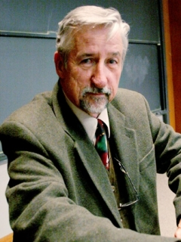
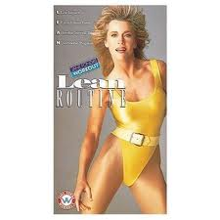
Tom Hayden and the New Left
http://www.nndb.com/people/153/000024081/
1966 – Hayden forms the SDS (Students for a Democratic Society) at the Univ. of Michigan, and issues the Port Huron statement (agenda for the New Left: environmentalism, opposition to the Vietnam War (400,000 Michiganders served), conscription, ROTC on campuses (Reserve Officer Training Corps)
1969 – MI passes law that any student convicted of participating in campus violence would not be eligible for state scholarships and tuition grants
New Left lost major issue with end of Vietnam War in 1975
Hayden later married fellow anti-war protester Jane Fonda
http://www.telegraph.co.uk/women/womens-life/10318821/Celebrity-bodies-we-coveted-from-Jane-Fonda-to-Jennifer-Lawrence.html

Slide 20
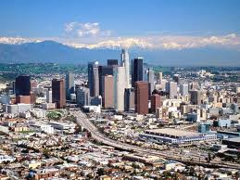
Detroit’s Declining Population
Population peak in 1950 at 1.85 million (5th largest city, just behind Los Angeles)
Now is 714,000 (18th largest city) while LA has 3.8 million (2nd largest)
http://www.prlog.org/11901609-title-loans-in-los-angeles-90001-will-help-pay-for-college-in-the-fall.html

Slide 21
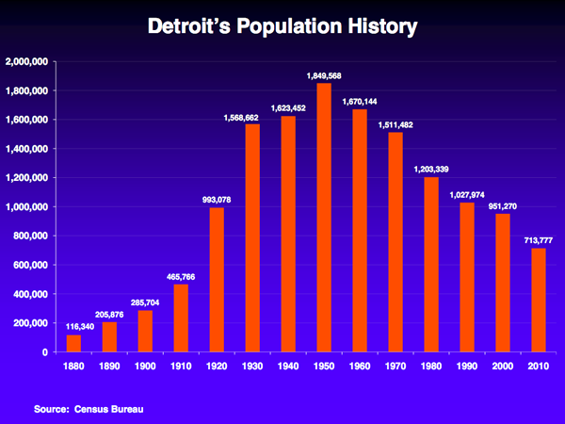
https://www.michigan.gov/snyder/0,4668,7-277-60279-295631--,00.html

Slide 22
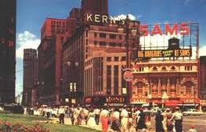
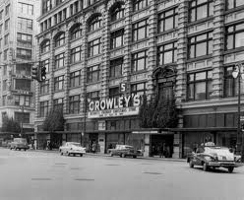
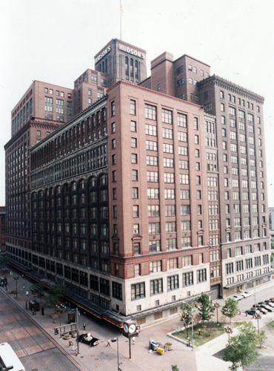
The Decline of Detroit
http://www.janwhitaker.net/bio.htm
1956 – Last streetcar in Detroit, downtown parking became scarce
1959 – Kern’s Department Store closes
1972 – S.S. Kresge’s HQ moves to Troy
1977 - Crowley’s Department store closes
1983 – Hudson’s closes
1992 – River Place Inn closes after three years
http://www.pinterest.com/pin/118782508895784196/
Hudson’s was once the world’s
largest department store
http://historicdetroit.org/building/hudsons-department-store/

Slide 23
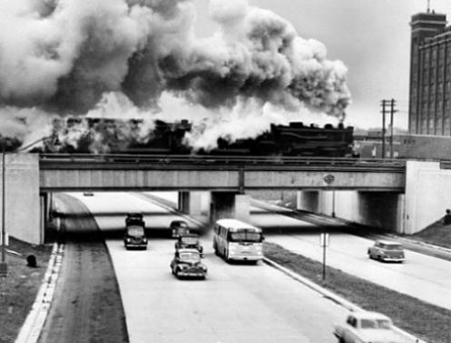
The Rise of the Suburbs
http://www.detroittransithistory.info/AroundDetroit/DetExpwyBusHistory.html
1954 – Northland Shopping Center opens, encouraging further movement to the suburbs
1954 - $840 million, 105 mile, Lodge-Ford freeway completed.
1963 – I-75 completed through Troy
1965 - Westland Mall is first enclosed mall in Michigan
1967 – Fisher Freeway and Chrysler Freeway (I-75) completed, destroying Black Bottom and Paradise Valley
WHITE FLIGHT STARTED BEFORE 1967 RIOT

Slide 24
Causes of Urban Riots in late 60s
Raised black expectations created by Great Society legislation
Lingering de facto segregation, discrimination and prejudice
Massive black migration to northern cities (>1 million per year)
Shortage of jobs created competition between whites and blacks, so high black unemployment
White police hassling black residents
Crowded living conditions, high temperatures

Slide 25
ParaDise Valley and Black Bottom

Slide 26
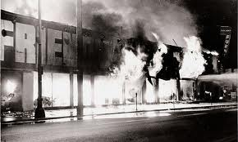
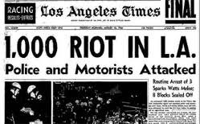
Watts riot
Watts (black section of LA) (Aug. 1965) – arrest of black for drunk driving escalated into a fight that led to 36 hour riot (34 dead, 900+ injured, $45 million in property damage). Worst riot since 1943 Detroit riot.
http://lbjlibrary.tumblr.com/post/33006819751/august-11-1965-the-watts-riots-break-out-in-los
http://questgarden.com/77/19/1/090227062426/process.htm

Slide 27
Detroit as a “Model City”
Biracial committee on human relations established after 1943 riot, and Gov. Williams appointed advisory committee on civil rights in 1949.
1955 – Fair Employment Practices Act – to prevent job discrimination
1962 – First constitutionally created civil rights commission in the U.S.
1960 – Blacks comprise 30% of Detroit’s population, and many become middle class
1962 - Mayor Jerome Cavanaugh enacts antipoverty program, and by 1967, Detroit had received $42 million in federal antipoverty funds

Slide 28
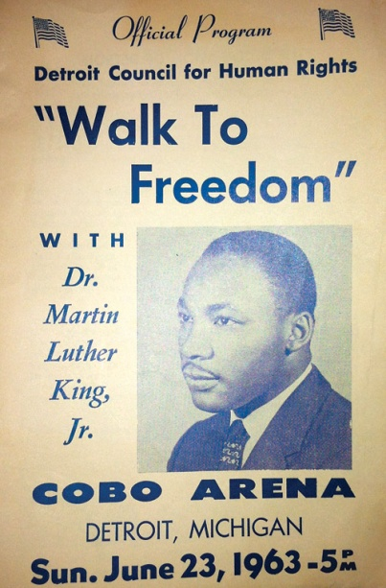
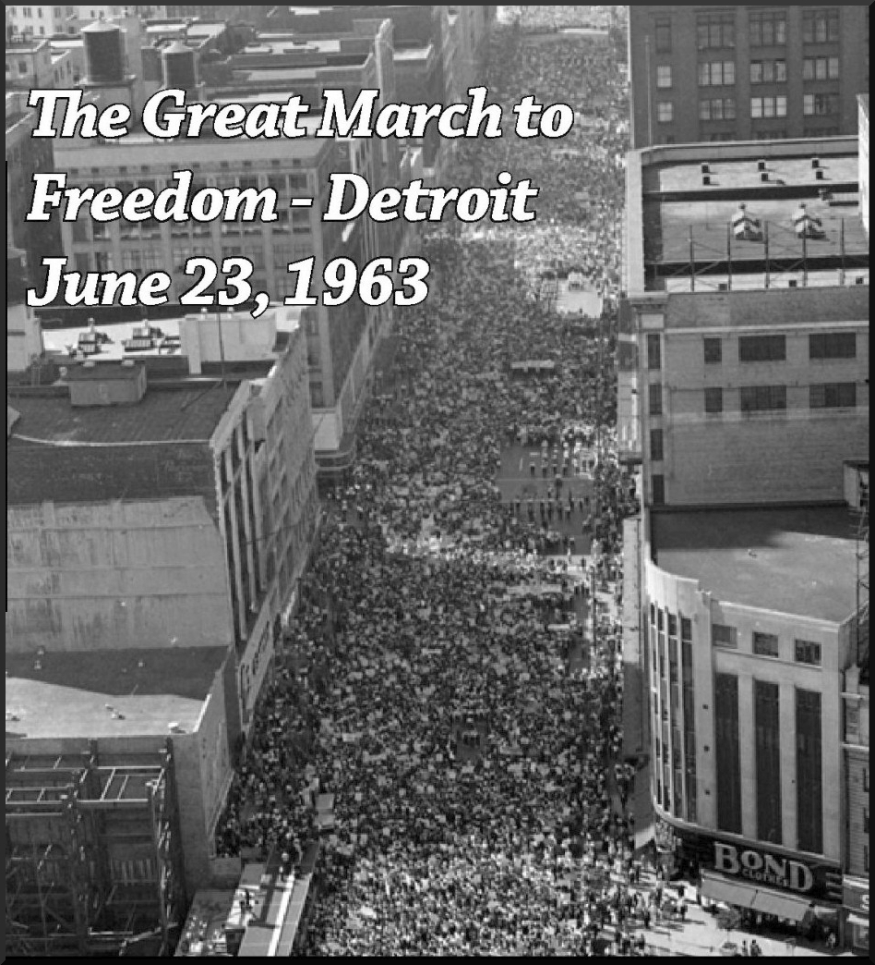
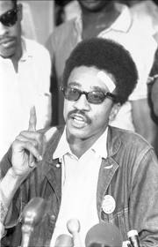
Detroit as a powder keg
http://ur.umich.edu/1213/Jan14_13/4226-mlk-photo-freedom
Housing segregated
Police force predominantly white, and blacks alleged harassment
Unemployment in Detroit was 11%, and higher among black youths
Gradualism of MLK increasingly rejected in favor of Malcolm X’s radical approach. Black Muslims started in Detroit in 1930. Malcolm X was assassinated in 1965.
MLK spoke at Cobo Hall in June 1963 two months before his famous “I have a dream” speech in Washington: “We want all of our rights. We want them here and we want them now.” 125,000 people marched in Detroit.
H. Rap Brown, Black Panther, spoke in Detroit in June 1967: “Motown, if you don’t come around, we’re going to burn you down.”
Summer of 1967 was hot and humid
http://www.lansinglabornews.org/index.cfm?zone=/unionactive/view_article.cfm&homeID=294216
http://delmardustpan.blogspot.com/2010/06/cambridge-race-riots-of-1960s.html

Slide 29
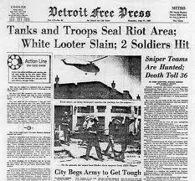
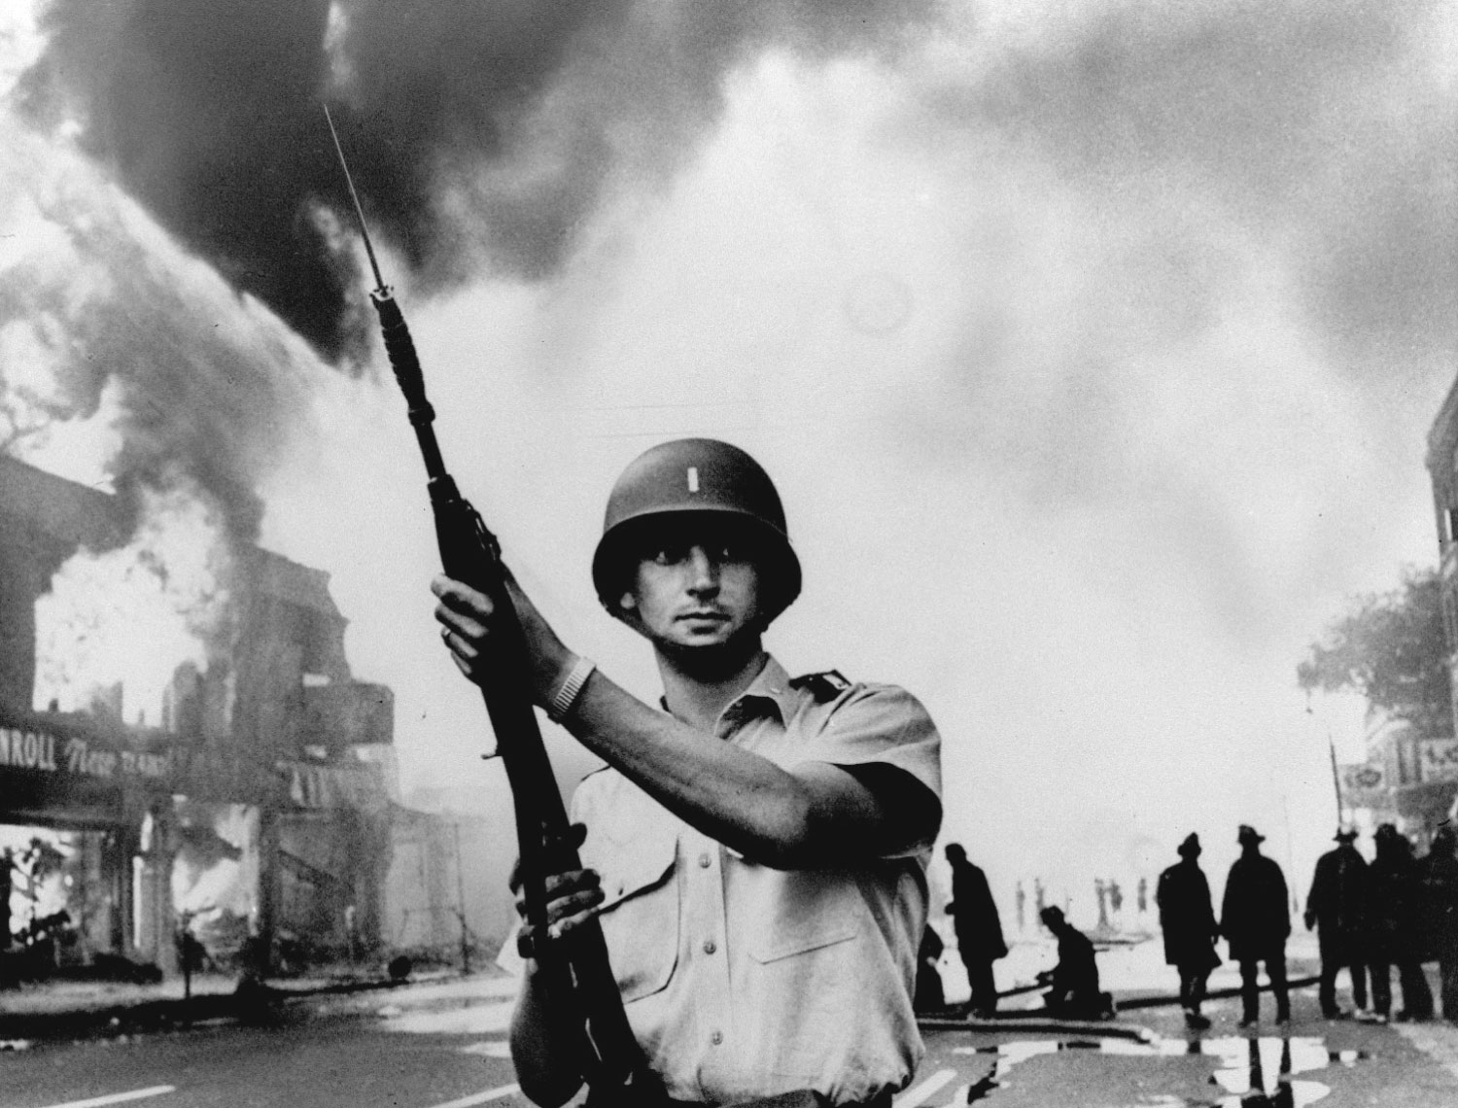
The Riot of 1967
http://www.mcrfb.com/?feed=rss2&cat=19
http://www.onthisdeity.com/23-july-1967-%E2%80%93%C2%A0the-detroit-riot/
Detroit (Sunday, July 23, 1967) – police raid a blind pig (illegal after-hours drinking establishment) and try to arrest patrons, but riot breaks out (lasted 5 days)
Mayor Jerome Cavanaugh ordered police to the scene, but told them to not forcibly disperse the rioters, who made no demands and who shouted down calls from black leaders like John Conyers to stop.
Gov. Romney calls out state police and national guard, then soon asks for federal troops, which don’t arrive until 48 hours after start of riot. Rioting continued for several more days (43 dead, 1,000+ injured, 2,509 stores burned, 7,331 arrests, 5,000 homeless, and $40-$80 million in damage). President LBJ, a Democrat, went on TV to criticize potential 1968 opponent Romney for not controlling riot.
Racial disturbances in Flint, Saginaw, and Grand Rapids at same time.

Slide 30
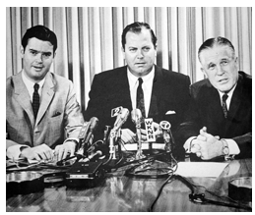
Response to Riots
Kerner Commission (1968) – said riots caused by white racism, discrimination, and segregation (recommended more gov’t programs)
Some said it was not a race riot, but a “criminal attack on property.”
White flight to suburbs to escape “mad dogs” and “lawbreakers”
Detroit integrated police and fire dept., made housing ordinances forbidding discrimination,
Citizen committee called New Detroit was formed, headed by J.L. Hudson Jr.
Joseph L. Hudson Jr., Mayor Jerome Cavanagh, and Gov. George Romney
http://www.newdetroit.org/cms/index.php/about-new-detroit/our-history

Slide 31
1965 Immigration Reform
Civil Rights Act of 1964
Voting Rights Act of 1965
Fair Housing Act of 1968
Immigration Act of 1965
No quotas from countries anymore, but can come if family is already here
The number of American residents born outside the country rose from 9.6 million in 1970 to more than 40 million in 2010 (81% came from Asia and Latin America, mainly Mexico).
Whites (or those that self-identify as whites) will be the minority in 2050.

Slide 32
Michigan in the 1970s
South continued to steal MI industry and auto factories with non-unionized labor and lower taxes
Detroit plagued with drug-related crime dubbed the “Murder City” in 1973 by Time magazine
1973 Arab Oil Embargo shifted auto production to smaller cars and Japanese cars start taking some of the Big 3’s market share
Urban renewal efforts in Detroit, Flint, and other cities

Slide 33


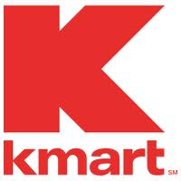
S.S. Kresge (K-mart)
http://logos.wikia.com/wiki/Kmart
Founded in 1897 in Detroit by Sebastian S. Kresge (1867-1966) as a “five and dime store.”
Incorporated in 1912, the S.S. Kresge Corporation was headquartered in Detroit until 1972, when it moved to Troy. The building housed 5,000 employees.
First K-mart built in Garden City in 1962
Kresge and Hudson’s anchored Oakland Mall in 1965.
S.S. Kresge Corporation renamed Kmart Corporation in 1977
Kmart went bankrupt in 2002, but was purchased by Sears in 2005
Now third leading retailer behind Walmart and Target
http://www.findagrave.com/cgi-bin/fg.cgi?page=gr&GRid=1280
http://en.wikipedia.org/wiki/Kmart

Slide 34
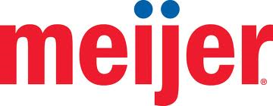
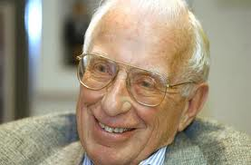
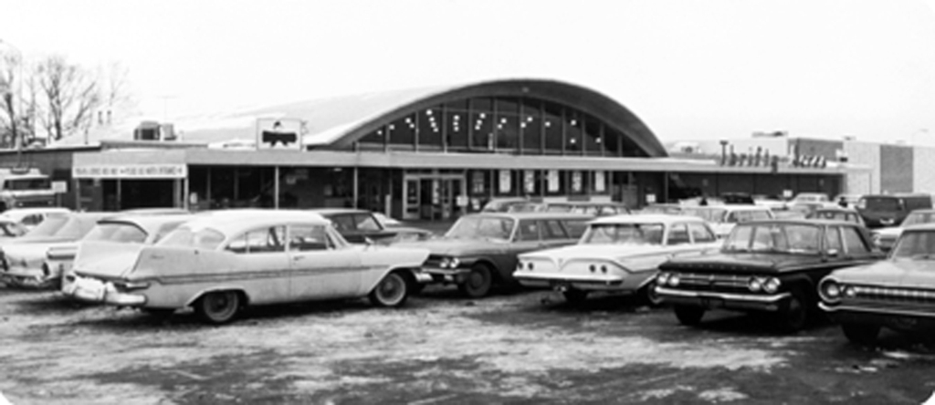
Hendrik G. Meijer and son Frederik opened grocery store in Greenville, MI in 1934.
In 1962, he put grocery and merchandise under one roof, called Meijer Thrifty Acres
Fred Meijer died in 2011 as the 60th wealthiest person in the U.S.
http://www.mlive.com/news/kalamazoo/index.ssf/2010/09/southwest_michigan_links_fred.html
http://www.progressivegrocer.com/top-stories/headlines/industry-intelligence/id35638/meijer-celebrates-50-years-of-supercenters/

Slide 35
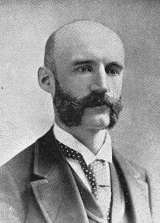
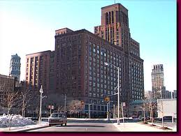

J.L. Hudson Company becomes Macy’s
Started in 1881 by Joseph L. Hudson
1969 – Bought by Dayton, a Minneapolis department store company to become Dayton-Hudson
1990 – Dayton-Hudson bought Marshall Field’s
2006 – Bought by May Department Stores to become Macy’s
http://en.wikipedia.org/wiki/Joseph_Lowthian_Hudson
The Hudson’s building in Detroit was the world’s tallest department store in 1961. It was demolished in 1998.
http://en.wikipedia.org/wiki/Hudson's
http://www.detroityes.com/downtown/09hudsons.htm

Slide 36
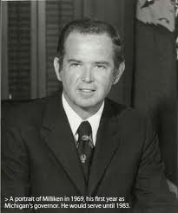
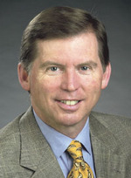
William G. Milliken (R)
1969-1983
http://www.hourdetroit.com/Hour-Detroit/February-2011/Milliken-Matters/index.php?cparticle=4&siarticle=3
Lt. Gov. under Romney led the moderate Republicans
Reelected twice, so longest-serving Governor from 1969 to 1983, but Democrats dominated during tenure.
Called the “ghetto governor” for increasing state aid to Detroit. Worked well with Coleman Young.
Major failure was the handling of the 1973 contaminated feed disaster (Cattlegate) that killed thousands of livestock. Someone mixed up PBB (cancer causing fire retardant) with Nutrimaster (a food supplement for dairy cattle).
Michigan ultimately got 75% reimbursement for damages from the federal gov’t to pay state farmers for livestock losses and medical expenses.
Milliken’s son, Bill Jr., is a commercial real estate broker and former president of the Michigan Association of REALTORS®
http://blog.mlive.com/ann_arbor_business_review/2008/01/greg_migliore_real_designers_w.html

Slide 37
Milliken vs. Bradley (1974)
NAACP (“Bradley”) filed lawsuit against Gov. Milliken to desegregate schools because there was a direct relationship between unfair housing practices (such as redlining) and educational segregation
1971 - U.S. District Judge Stephen Roth orders busing from Detroit to suburbs to integrate schools, but U.S. Supreme Court overturned in 1974. S.C. said blacks choose to self-segregate by living in Detroit, so suburbs should not be blamed if school district lines are not drawn with racist intent. ENDED BUSING, so blacks stuck in inner city schools.

Slide 38
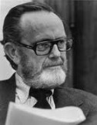
Philip A. Hart (D)
Lieutenant Gov. under G. Mennen Williams in 1954 and 1956
18 year Senator from 1958-1976
Favored civil rights, consumer protection, and regulation of big business
Backed busing for school integration
Backed safety and anti-pollution legislation that angered Big 3.
Favored gun control
Called the “Conscience of the Senate”
Sleep Bear Dune Visitor Center named after him, as was Hart Plaza in Detroit
http://en.wikipedia.org/wiki/Philip_Hart

Slide 39

Michigan State Lottery
1964 – New Hampshire is first state with lottery
1972 – Michigan voters approve lottery (6th state to follow New Hampshire)
Money was supposed to go only to schools, but has been used for general fund
http://www.lotteryuniverse.com/michigan-lottery.aspx

