Slide 1
The Great Depression and WWII
1929-1945

Slide 2
Causes of the Great Depression
1.) Uneven economic growth = Older industries (railroads, farming, mining, textiles, steel barely made a profit)
2.) Overproduction = too little demand, so prices fell, which lowered wages
3.) Uneven distribution of income = concentrated in hands of a few, not the many (richest 5% get 33% of all income) wealthiest lost the most
4.) Excessive buying on credit = Americans were overextended (installment loans soared)
5.) Credit crunch = banks had “runs”, failed to collect debts, failed to lend, so went out of business, even before 1929

Slide 3
How bad was it?
Dow fell to 41 (from 382) in 1932
Exports were lowest since 1905
90,000 businesses failed
Unemployment rose from 3% to 25% in 1933 (American industry = 46%)
9,000 banks closed (25% of all banks - depositors lost $2.5 billion)
Income dropped 35% between 1929-1933
Farmers destroyed crops to raise prices
Bread marches, rent riots, strikes, protests

Slide 4
Tough times for auto industry
1929 Auto production – 5.3 million
1930 Auto production – 3 million
1931 Auto production – 1.3 million
1933 – Durant Motors goes bankrupt
1936 – Reo switched to making trucks instead of cars
1938 – Packard introduced a lower-priced Packard to boost sales, but loses prestige

Slide 5
How bad was it in Michigan?
Unemployment (non-agricultural workers) reached almost 50% in 1933
Almost all mines in U.P. stopped production in 1932-1933
1930 – Counties can erect poorhouses (first in Wayne County in 1932)
State government were unable to provide enough relief, so federal gov’t loaned $21 million to Michigan through the Reconstruction Finance Corporation
1932 – 25% of all Michigan banks failed
1935 – Social Security Act paid pensions to retired workers.
1836 – Employment Security Commission (MESC) paid unemployment insurance benefits to workers
1937 – Counties must create Bureau of Social Aid
1939 – Social Welfare Act – MI counties create department of social welfare

Slide 6
Americans Face the Depression
“Making Do”
  “Use it up, wear it out, make it do, or do without” (families moved in with relatives)
  Birth rate declined, less divorces, less marriages
Discrimination and Depression
  As unemployment rose, so did pressure to NOT hire married women and minorities, and give jobs to white men

Slide 7
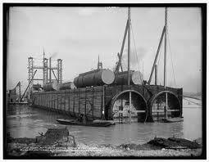
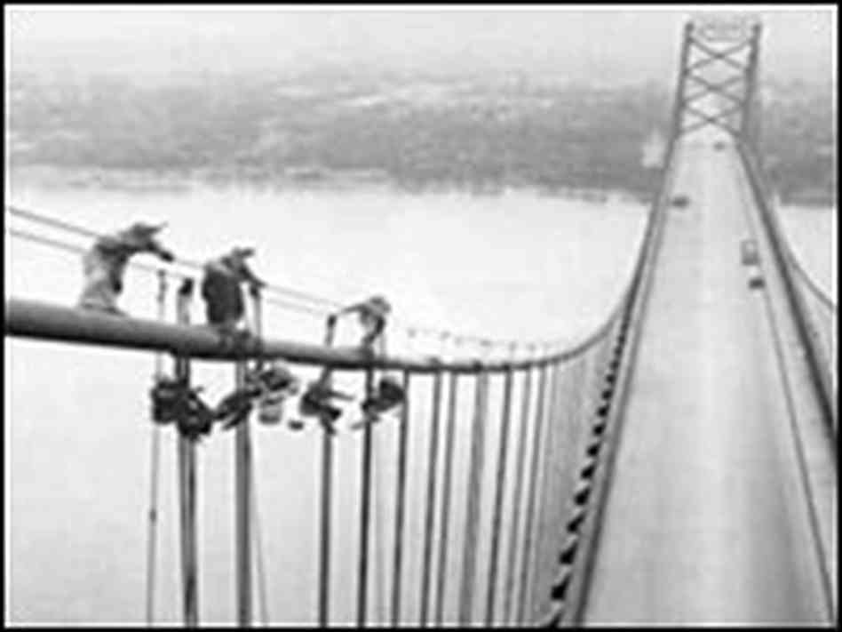

Ambassador Bridge
Completed in Nov. 1929 below cost
Had the longest suspended central span of any bridge in the world until the George Washington Bridge in 1931.

Slide 8
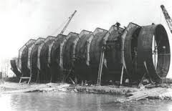
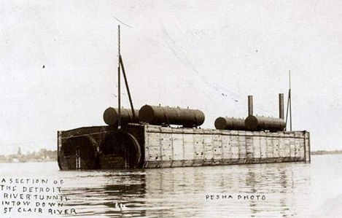
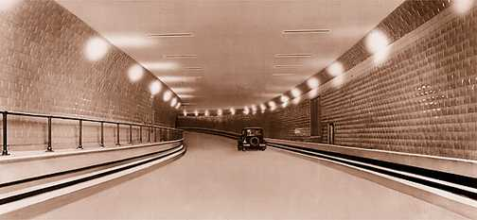
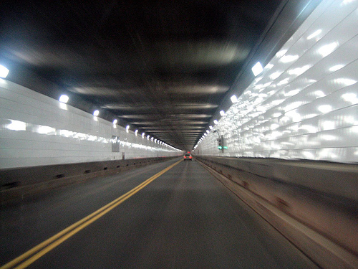
The Detroit-Windsor Tunnel
http://www.freep.com/article/20131103/NEWS06/311030066/michigan-history-detroit-windsor-tunnel-opens
The prefab sections were 31’ in diameter. There were nine sections of tube, each 250 feet long and weighing 8,000 tons. Construction took 26 months to complete -- 10 months quicker than had been anticipated.
http://www.michiganrailroads.com/RRHX/Stations/CountyStations/WayneStations/DetroitTerminal/TunnelConstruction.htm
After a trench was dug in the river bed, barges floated prefabricated sections of steel into position and strategically sinking them into the trench (“immersed tube” or “trench and tube” method) After the tubes were laid in the trench divers bolted the sections end-to-end, and cemented the joints.
http://www.borderbookmobile.net/archives/ongoing-research/
More than 20,000 vehicles use the mile-long tunnel each day.
A 1929 Studebaker was the first car that went through the tunnel in 1930.
http://en.wikipedia.org/wiki/Detroit%E2%80%93Windsor_Tunnel

Slide 9
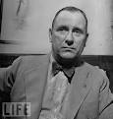
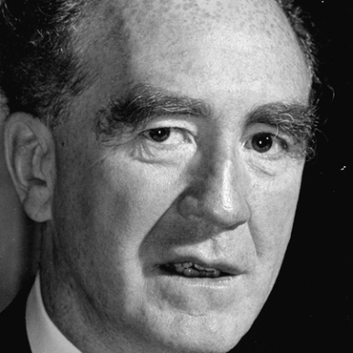
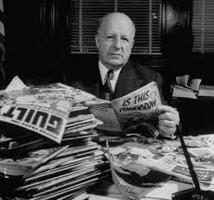
1932 Ford Hunger March
http://nuldi.com/the-real-history-of-john-dillinger-and-henry-ford-182618
The welfare allowance was 15 cents per person per day. There was no unemployment insurance. A wave of bank closures wiped out the life savings of many unemployed workers and retirees, as every neighborhood bank in Detroit went out of business. 568 suicides in Detroit in 1932.
Unemployed Ford employees and others (3-5,000) marched from Detroit to Dearborn, funded by the Communist Party USA. At the Dearborn city limits, police fired tear gas to disperse the crowd, who then threw stones. Dearborn Police and Ford’s “security,” under Harry Bennett, shot and killed 5 workers and 60 more were injured, mainly by gunfire.
Newspapers blamed Communists for inciting workers. Detroit Mayor Frank Murphy called Henry Ford a “terrible man” and Harry Bennett an “inhumane brute.”
Wayne County Prosecutor Harry Toy, a stanch anti-communist, called the protesters’ actions “unlawful.”
Led to the formation of the United Auto Workers in 1935
Bennett was head of Ford’s “Service Department” from the mid 1920s to 1945.
Harry Toy, shown looking at comics for communist teachings, was elected to the Michigan Supreme Court in 1935, and was the Detroit Police Commissioner from 1947 to 1950
Murphy became
Governor in 1936.
http://www.biography.com/people/frank-murphy-9418715
http://boards.collectorssociety.com/ubbthreads.php?ubb=showflat&Number=4092080&fpart=3

Slide 10
The Growth of Labor Unions
Strikes broken up by federal troops, state national guard, or private security “goons” (Pinkertons) during the Gilded Age
1889 – Michigan Federation of Labor started, and helped pass child labor and prison labor legislation, but was disorganized and weak until the 1935 Wagner Act allowed unions and collective bargaining. Industrial unions, comprising all workers, grew (mining, clothing, auto workers = UAW in 1935)

Slide 11
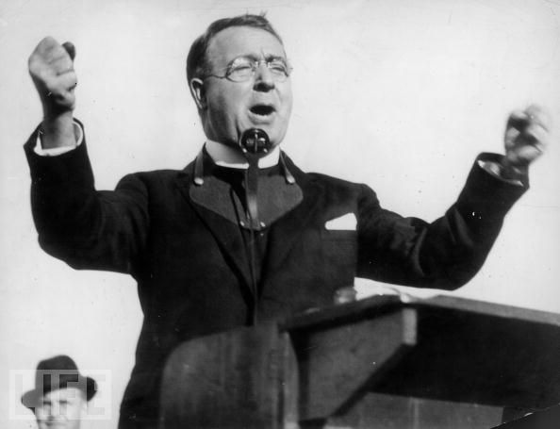
“The Radio Priest”
Father Charles Coughlin – Catholic priest from Royal Oak Shrine of the Little Flower urged his listeners to vote for FDR in 1932, but later said New Deal didn’t go far enough in ensure social justice. NRA failing to compel employers to meet with unions and raise wages, so many strikes occurred. Favored guaranteed annual income, tough antimonopoly laws, and nationalization of banking. Founded the anti-Semitic National Union for Social Justice.
http://www.history.com/topics/michigan/speeches#coughlin-denounces-new-deal

Slide 12
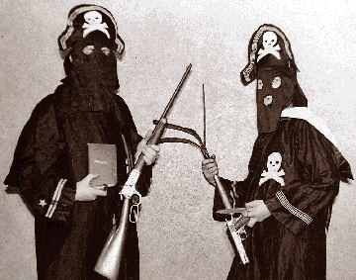
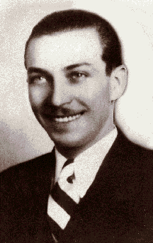
The black legion
Detroit branch of the Ku Klux Klan with an estimated 20-30,000 members
Wore black robes instead of white KKK robes
Many were transplanted poor Southerners who targeted blacks, Jews, Catholics, and suspected communists.
Killed an estimated 50 blacks from 1931 to 1936
The murder of Charles Poole, whom the Black Legion accused of beating his wife, led to life sentences for 11 members, effectively ending their reign of terror in 1936.
http://www.veteranstoday.com/2012/11/28/history-the-black-legion-where-vets-and-the-klan-met/
http://www.veteranstoday.com/2012/11/28/history-the-black-legion-where-vets-and-the-klan-met/

Slide 13
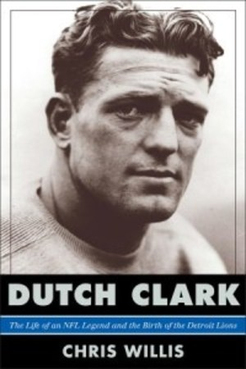
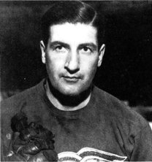

City OF CHAMPIONS
http://voices.yahoo.com/book-report-dutch-clark-11720998.html?cat=38
Lions win NFL Championship, led by Hall of Famer QB Dutch Clark and RB Ernie Caddel (“the Blond Antelope”)
Red Wings win Stanley Cup, led by C Marty “Goal a Game” Barry
Tigers win the World Series, led by Hall of Famers Mickey Cochrane (catcher-coach), Hank Greenberg, and Charlie Gehringer
Joe Louis was named the AP’s Most Outstanding Athlete of 1935
http://www.fanbase.com/Marty-Barry
http://www.baseball-reference.com/players/c/cochrmi01.shtml

Slide 14
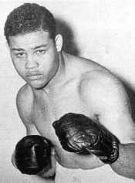
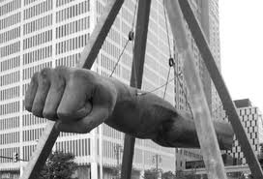
JOE LoUIS
http://blackusa.com/joe-louis/
Called the “Brown Bomber”
Becomes heavyweight champion in 1937 by defeating German Max Schmeling with 1st round KO. In first fight in 1936, Schmeling won in 12 rounds with a knockout.
Retained title until 1949.
Louis became the “first true African American national hero in the U.S.”
“The Fist” sculpture was dedicated in 1986

Slide 15
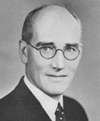
Michigan Turns Democratic
http://www.columbia.edu/cu/zetapsi/zetapsi-history.htm
Since 1854, Republicans dominated
In 1932, William Comstock (D) defeated incumbent Gov. Brucker (R), and Dems won a majority in legislature (in 1924, there were no Democrats in MI legislature)
Voters in 1932 approved 15 mill limit (1.5% of property value) on property taxes , so Democratic legislature approved 3% sales tax, and variety of other taxes (beer and wine tax, chain-store tax, horse-race wagering tax, stocks and bonds tax, etc.). Sales tax led to Comstock’s defeat in 1934, and Republican Frank D. Fitzgerald won.

Slide 16
Gov. William Comstock
Conservative Democrat
1933 – Comstock closed banks from Feb. 14 to March 21. Bank Holidays increased unemployment
FERA (Federal Emergency Relief Admin.) assisted 640,000 people in Michigan
CWA, WPA, PWA, and CCC (103 camps in MI) gave people jobs in public projects

Slide 17
Election of 1936
http://www.biography.com/people/frank-murphy-9418715
FDR campaigned in Michigan to get Catholic Frank Murphy, former mayor of Detroit, to win governorship. Maverick like Pingree, Osborn, Groesbeck, and Couzens.
Murphy promised a “Little New Deal”: implemented New Deal social reforms, and established a civil service system (no more spoils system)
1940 – Amendment to Constitution creates civil service commission to determine salaries, hiring, and firing of most state employees
1938 – Murphy loses to Republican Frank Fitzgerald, who died in office in March 1939.
Murphy later became Attorney General for FDR and associate justice of the U.S. Supreme Court.

Slide 18
The Birth of the UAW in 1935
200 delegates meet in Detroit to form the United Auto Workers.
First president is Francis Dillon, appointed by the AFL (American Federation of Labor)
1936 – UAW elects its own president, Homer Martin.
1937 – Chrysler workers gain UAW recognition
1937 – North American Aviation recognizes UAW

Slide 19
UAW takes on GM in Flint
UAW protested speedup of assembly lines, bad work conditions and low wages
12/30/36 – Sit-down strike at Fisher Body Plant in Flint to prevent GM from using strikebreakers (scabs)
Gov. Murphy sends National Guard to keep order, but not remove men from factory. GM said no negotiation until plant was evacuated.
FDR wanted both side to negotiate, so agreement to recognize UAW as the bargaining agent was reached on March 12, 1937.

Slide 20
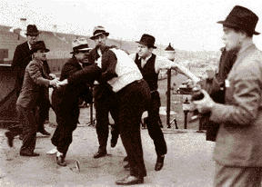
Battle of the overpass
http://en.wikipedia.org/wiki/Battle_of_the_Overpass
Chrysler recognized UAW, but Ford did not
May 26, 1937 – Battle of the Overpass – Ford uses Harry Bennett’s “goons” to beat up union officers, but Supreme Court upholds Wagner Act
1941 – Rouge plant workers walked out, so Ford threatened to close Ford, but wife, Clara, threatened to leave him, so Henry Ford gives in to the union allowing a “closed shop” (must belong to union)
http://nuldi.com/the-real-history-of-john-dillinger-and-henry-ford-182618
A former boxer and ex-Navy sailor, Bennett was the
head of Ford’s Service Department, or Internal Security.

Slide 21
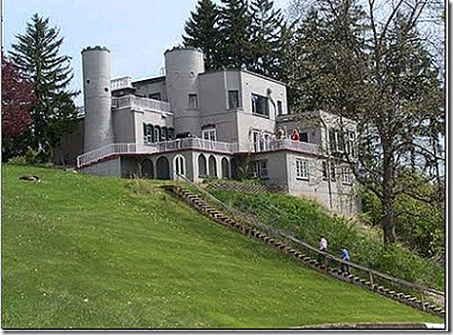
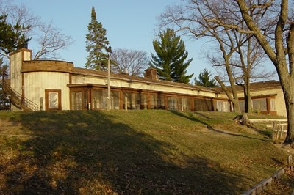
Bennett’s Castle and Lodge
Bennett’s Castle in Ypsilanti
Bennett’s Lodge in Clare
http://www.cincinnatireview.com/blog/tag/harry-bennett/
http://www.retrokimmer.com/2010/09/harry-bennetts-lodge.html
Harry Bennett was paranoid about being attacked, so he built immense fortifications dubbed “The Lodge” (in Clare) and “The Castle,” (in Ypsilanti) complete with dynamited moats, secret passageways, uneven-height stairs, caches of arms and ammunition, escape routes to the dock or airfield, and even lions and tigers.
The Lodge, built to look like a log cabin, is now run by the Boy Scouts as the Lost Lake Scout Reservation.

Slide 22
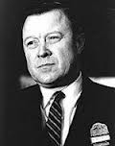
Walter Reuther
http://www.born-today.com/Today/09-01.htm
Born in West Virginia, the son of a Socialist brewery worker
Joined Ford in 1927 as tool and die worker, but laid off in 1932 perhaps due to his Socialist ties, and then worked in a Soviet auto plant for two years.
Came back to Detroit to head Local 174 with 100,000 auto workers in 1936
1937 – Battle of the Overpass
1940 – Won major strike against GM to gain union recognition
1941 – Won major strike against Ford to gain union recognition
1945 – GM strike – Walter Reuther asked for 30% pay increase, but gets 15% and was elected president of the UAW in 1946. Survived assassination attempt in 1948, and led the UAW (and CIO in 1952) until 1970. In the 1940s, UAW started siding with New Deal Democrats wanting reforms.
1955 – AFL merges with CIO.

Slide 23
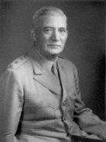
Michigan during WWII
http://en.wikipedia.org/wiki/William_S._Knudsen
670,000 Michigan men and women inducted
William Knudsen, president of GM, was appointed by FDR to head the Office of Production Management to oversee industrial production of wartime materials
2/10/42 – the federal government took over all private industries capable of producing war material. This meant for the duration of the war no more cars would be produced.
Auto industry produced $50 billion of war materials, mostly aircraft and aircraft parts, and military vehicles and parts, including tanks
Tires and gasoline rationed

Slide 24
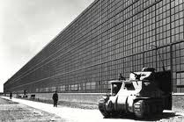
The Arsenal of Democracy
Chrysler Tank Arsenal (Detroit Arsenal Tank Plant) in Macomb County made 25,000 tanks, over 25% of U.S. total. Made tanks for the Korean War too.
http://www.e-architect.co.uk/architectural-events

Slide 25
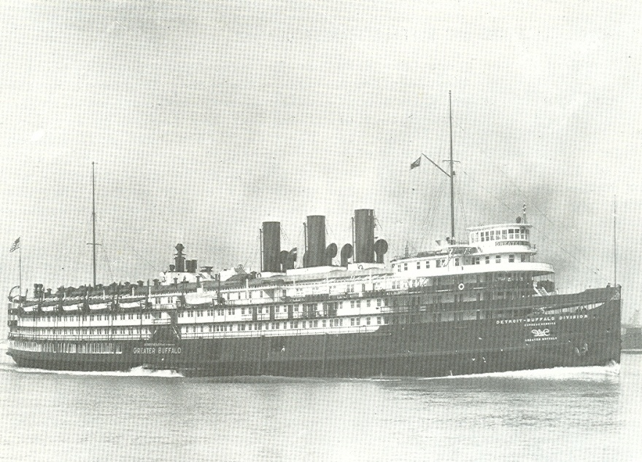
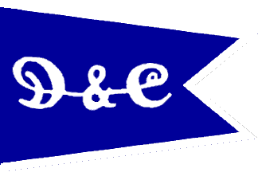
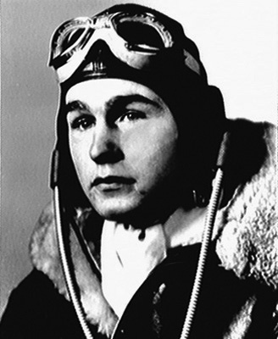
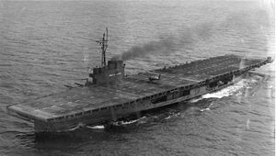
The Greater Buffalo becomes the USS Sable
http://www.achievement.org/autodoc/photocredit/achievers/bus0-012
http://www.acbs-bslol.com/porthole/paddlewheeler.htm
http://www.crwflags.com/fotw/flags/us~hfd.html
George H.W. Bush flew training missions on the USS Sable in Lake Erie, which simulated ocean conditions.
To aid the war effort, the federal government converted the Detroit & Cleveland Navigation Company’s Greater Buffalo into the USS Sable, an aircraft carrier.
http://en.wikipedia.org/wiki/USS_Sable_(IX-81)

Slide 26
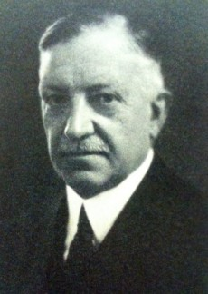
George D. Mason – Architect
http://www.google.com/imgres?imgurl=http://historicdetroit.org/image/2/0/324/2/images/georgemason.jpg&imgrefurl=http://historicdetroit.org/architect/george-d-mason
Pontchartrain Hotel
Century Theatre
Gem Theatre
Masonic Temple
Detroit Yacht Club
Grand Hotel
Lincoln Motor Company Plant
2nd Detroit Opera House
First Presbyterian Church of Detroit
Mentor for Albert Kahn, Detroit’s most famous architect

Slide 27
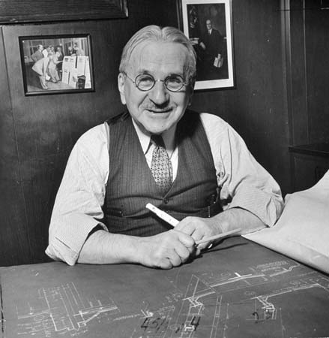
Albert Kahn – Detroit’s most famous architect
Detroit Athletic Club
The Dearborn Inn
Detroit Arsenal Tank Plant in Warren, Michigan
Edsel and Eleanor Ford House in Grosse Pointe Shores
Fisher Building
Belle Isle Aquarium and Conservatory
Packard Motor Car Company factory
Ford Rouge plant
The Detroit News
The Detroit Free Press
Willow Run
Kahn designed over 1,000 buildings
http://kids.britannica.com/comptons/art-137689/The-architect-Albert-Kahn-works-with-blueprints-in-about-1939

Slide 28
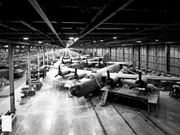
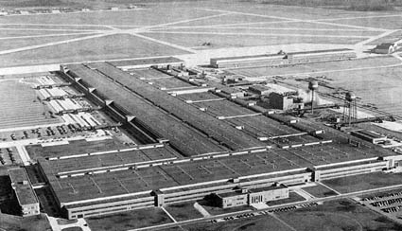
Willow Run
Ford Willow Run Plant east of Ypsilanti made 8,500 B-24 Liberator bombers. $100 million plant designed by Albert Kahn, opened in Sept. 1942. $20 million village created, and full-scale airport. By end of 1943, made one bomber per hour. Edsel Ford died in May 1943, so 80 year old Henry tried to take over, but FDR arranged for grandson, Henry Ford II, to be released from naval duty. He won power struggle for presidency in 1945.
http://www.motorcities.org/Story/Willow+Run+The+Factory+and+the+B24+Bombers+br+By+Margery+Krevsky-165.html
http://www.yellowairplane.com/book_reviews/warren_benjamin_kidder/willowrun_cover.html

Slide 29
Another Great Migration
15 million moved north between 1941-1945
Most went west to defense industry jobs (ships, aircraft)
Rapid growth of major cities everywhere caused problems with crime, sanitation, divorce, juvenile delinquency, truancy
Detroit pop. in 1940 = 1.6 million
Detroit pop. in 1943 = 1.85 million (including 50,000 blacks and 300,000 white southerners)
Detroit’s black population in 1943 was 200,000 (11%)

Slide 30
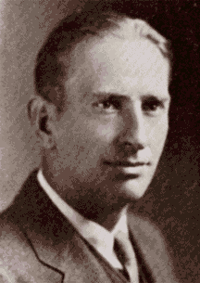
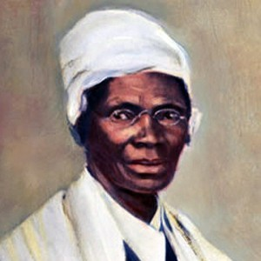
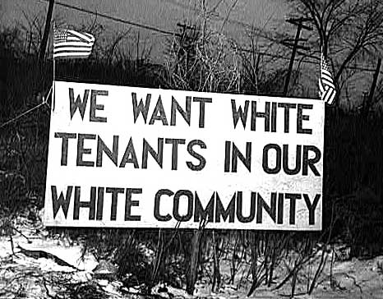
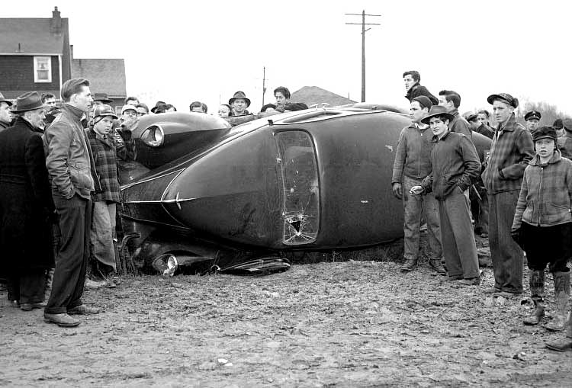
Sojourner Truth Housing Project
https://www.mtholyoke.edu/courses/rschwart/clio/detroit_riot/DetroitNewsRiots1943.htm
There was only one black housing project in the city, the Brewster housing project and it was full. Southern whites were also competing for housing. Locals were under the impression the new housing project was intended for whites until it was given the name Sojourner Truth (after a famous black woman who was a slave, an abolitionist, and suffragist) in September 1941.
Blacks tried to move in on Feb. 27, 1942, but blocked by 1,200 whites. Later that day, two black tenants ran their car through the picket line, starting off a melee. Detroit police used tear gas and shotguns to disperse the crowd but moving day had to be postponed indefinitely. Blacks finally moved in two months later when Detroit Mayor Edward Jeffries called in 1,600 National Guardsmen and 1,100 police officers.
In August 1942, ten months before the notorious riot, LIFE magazine wrote an article entitled “Detroit is Dynamite”
Jeffries proposed a highway system for metro Detroit
http://www.detroits-great-rebellion.com/Detroit---1943.html
http://www.stlamerican.com/entertainment/living_it/article_e84e8852-9d4b-11e0-bf38-001cc4c03286.html
http://en.wikipedia.org/wiki/Detroit_Race_Riot_(1943)

Slide 31
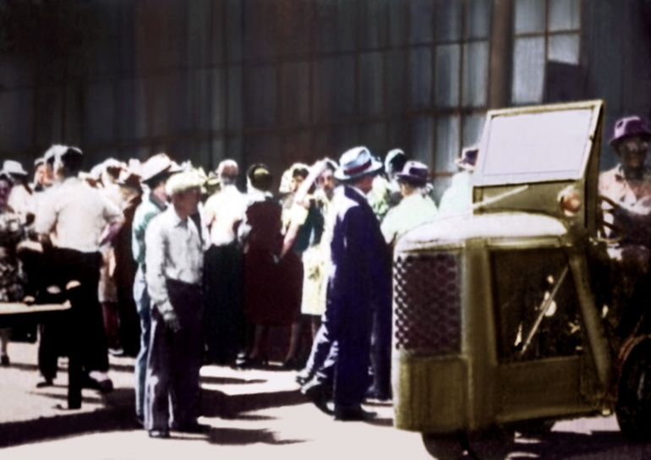
Packard “Hate Strike”
http://www.lawyersgunsmoneyblog.com/2012/06/this-day-in-labor-history-june-6-1943
The Packard Motor Car Company produced giant Rolls-Royce aircraft engines and twelve cylinder Packard marine engines used to power PT boats.
Whites didn’t mind that blacks worked in the same plant, but they refused to work side by side with them. Three weeks before the riot, Packard promoted three blacks to work on the assembly line next to whites. A plant-wide hate strike resulted as 25,000 whites walked off the job, bringing critical war production to a screeching halt. A voice with a Southern accent barked over the loudspeaker, “I’d rather see Hitler and Hirohito win than work next to a Nigger.”
Blacks were reassigned, ending the “hate strike.”

Slide 32
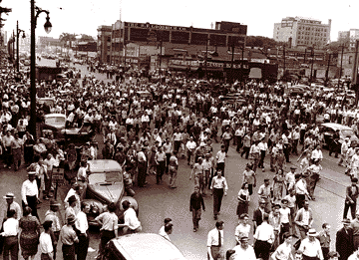
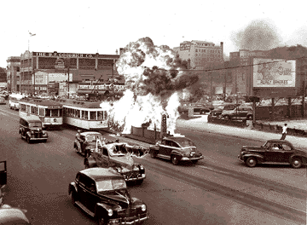
1943 Detroit Riot
June 20, 1943 – riot erupts on Belle Isle when black man insulted white woman
June 21, 1943 – Federal troops arrive, and restored order 2 days later, but 25 blacks and 9 whites dead, and 1,800 arrested
Both images: https://www.mtholyoke.edu/courses/rschwart/clio/detroit_riot/DetroitNewsRiots1943.htm

Slide 33
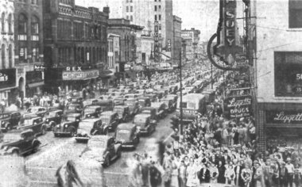
America wins the war
http://www.mlive.com/news/jackson/index.ssf/2011/08/peek_through_time_66_years_ago.html
500,000 people celebrate on August 14, 1945 on Michigan Avenue

Slide 34
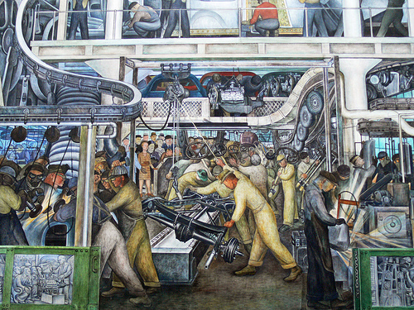
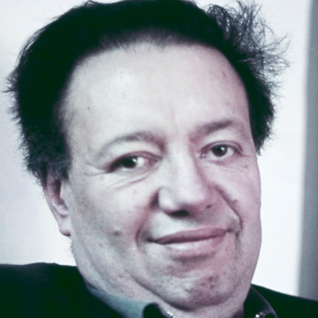
Detroit Industry by Diego Rivera
http://www.biography.com/people/diego-rivera-9459446
  Diego Rivera was a Mexican Marxist who painted the “Detroit Industry” mural of 27 fresco panels at the DIA in 1932-33. He modeled it after Ford’s Rouge Plant.
http://subrealism.blogspot.com/2010/03/lesson-from-great-depression.html

